Slide 1


Why your ?-seq analyses can be somewhere from mildly to wildly wrong
Greg Gloor
The University of Western Ontario, London, Canada; ggloor@uwo.ca

Slide 2

It is all about me!
phage to flies to molecular evolution to microbiome to ?
Where I am in a personal journey to understand the new reality in biology and biomedical science

Slide 3
False hopes for HTS?
We believe high sequencing depth equates to lots of data
We believe that we can extract information from datasets that break the assumptions of statistics
We believe that someone else got it right because data analysis is easy
We believe many HTS experiments that have serious flaws

Slide 4

Best quote ever!?
There are known knowns. These are things we know that we know.
There are known unknowns. That is to say, there are things that we know we don't know.
But there are also unknown unknowns. There are things we don't know we don't know.
There are unknown knows: That is, there are also things we think we know that we don’t know
Donald Rumsfeld

Slide 5
One category that he missed
There are known knowns. These are things we know that we know.
There are known unknowns. That is to say, there are things that we know we don't know.
But there are also unknown unknowns. There are things we don't know we don't know.
There are unknown knowns: That is, there are also things we think we know that we actually don’t know

Slide 6
Where does HTS data come from?
DNA or RNA fragments from the environment
A random sample is used to make a library
A random sample of the library is sequenced and mapped
This generates a table of counts per feature (OTU, gene) in each sample
The number of reads is determined by the machine!
Notes:
Many more fragments than we can count

Slide 7
So why is it analyzed differently?
RNA-Seq
Analysis methods grew out of SAGE
Assumes negative binomial
Works well for ideal datasets
16S rRNA gene sequencing
Analysis methods grew out of ecology
Assumes proportions in a constant sampling area
All differences go to 1
Tools from one domain to not translate to the other
Notes:
Many more fragments than we can count

Slide 8
So why is it analyzed differently?
RNA-Seq
Analysis methods grew out of SAGE
Assumes negative binomial
Works well for ideal datasets
16S rRNA gene sequencing
Analysis methods grew out of ecology
Assumes proportions in a constant sampling area
All differences go to 1
Tools from one domain to not translate to the other
Notes:
Many more fragments than we can count

Slide 9
The real problems
The number of reads is determined by the machine
Data are arbitrarily constrained
The data are actually very variable
But the variation is not where you think
Notes:
Many more fragments than we can count

Slide 10
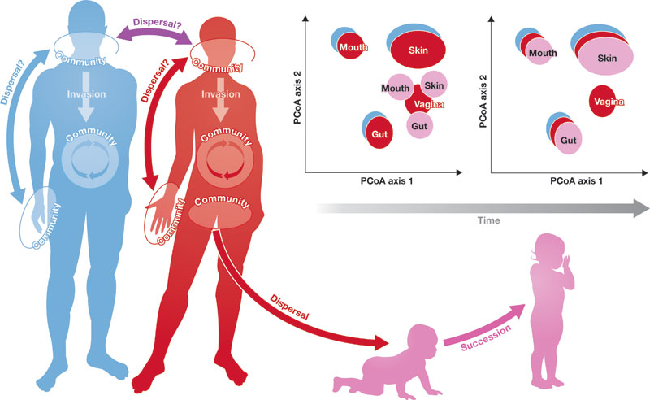
Assumption
The total number of molecules examined is the same between environmental samples

Slide 11
Reality
The total number of molecules examined is not the same between samples
Bacterial load is not constant between environments
The total RNA level is not constant between growth states, tissues or organisms
The control and experimental antibody have different affinities and numbers of targets
etc ……

Slide 12
We have a difference!
Human Gut, 16S rRNA gene sequence, Healthy vs nonalcoholic steatohepatitis

Slide 13
Do we have a difference?
Human Gut, 16S rRNA gene sequence, Healthy vs nonalcoholic steatohepatitis

Slide 14
What causes the difference?
Human Gut, 16S rRNA gene sequence, Healthy vs nonalcoholic steatohepatitis

Slide 15

Sequencing data are high-dimensional
Therefore statistical analyses can be wildly optimistic
Sequencing data are sparse
Therefore we need to estimate many of our values
Sequencing data are compositional
Therefore everything correlates with everything
Most of us are unaware of the problems

Slide 16
The biggest problem is -
Sequencing data are high-dimensional
Therefore statistical analyses can be wildly optimistic
Sequencing data are sparse
Therefore we need to estimate many of our values
Sequencing data are compositional
everything correlates with everything
Most of us are unaware of the problems

Slide 17
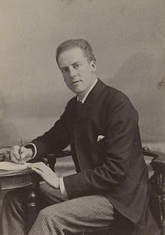
Karl Pearson - 1896
From the above examples it will be seen that the method which judges of the intensity of organic correlation by the reduction of all absolute measures to indices, the denominators of which are some one absolute measurement, is not free from obscurity; for this method would give the major portion of the observed index correlation had the parts of the animal been thrown together at random, i.e., if there were no organic correlation at all

Slide 18
Karl Pearson - 1896
In other words –datasets of constant sum are not what they seem to be: spurious correlation is a major unappreciated problem whenever a ratio is involved
RV 2/RV 3
RV 1/RV 3

Slide 19

Compositional data are constant sum datasets
Either imposed or by design (Aitchison, 1986)
Proportions, %, ppm
Reads per instrument capacity
Recall that the sequencer imposes an arbitrary limit on the number of reads obtained

Slide 20
The problem is geometrical
X = [x1,x2,x3] = anything
Is not
X = [x1,x2,x3] = constant
Notes:
Many more fragments than we can count

Slide 21
The problem is geometrical
Data are bounded by real numbers that must be positive
A value of 0 represents an infinity on one or more axes
Differences are non-linear
Notes:
Many more fragments than we can count

Slide 22
NON-LINEAR RESPONSE
Here we can see the non-linear relationship between what we want to examine, and what we can examine!
x =[x₁,x₂ … x_{n}] p =[p₁,p₂ … p_{n}]
Aitchison, 1986, The statistical analysis of compositional data
Notes:
Many more fragments than we can count

Slide 23
and NEGATIVE CORRELATIONS
Here we can see the negative correlation bias – if one thing goes up, something else has to go down
x =[x₁,x₂ … x_{n}] p =[p₁,p₂ … p_{n}]
Aitchison, 1986, The statistical analysis of compositional data
Notes:
Many more fragments than we can count

Slide 24
Log-ratio transformations
x =[x₁,x₂ … x_{n}] p =[p₁,p₂ … p_{n}] clr(x) = [log2(x₁/gx),
log2(x₂/gx) … log2(x_{n}/gx)]
(gx is the geometric mean of vector)
Aitchison, 1986, The statistical analysis of compositional data
Notes:
Many more fragments than we can count

Slide 25
Requirements for analysis
The three rules of CoDa analysis
Conclusions must be scale invariant
(ppm, %, normalized counts, etc)
Conclusions must be permutation invariant
qPCR fails this
Conclusions must be subcompositionally coherent
Everything we examine is a subcomposition
Principle is that we can only examine ratios between components!
Andrew’s rule:
Conclusions must be robust to sampling

Slide 26

Goals
Given a set of data with two or more groups derived from high throughput sequencing
Is the composition of the groups different?
What are the univariate differences between the groups?
What correlates with what?
Notes:
Many more fragments than we can count

Slide 27
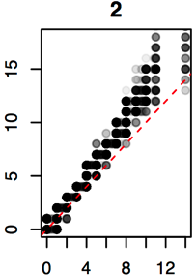
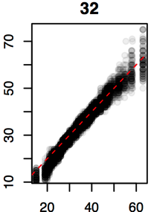
Real sequence data are variable
Count = 2
Count = 32
Same genes from same samples from the same library, sequenced on different lanes
We should get comparable answers regardless of when, where, how we sequence
We can estimate the variability by sampling Dirichlet or random multinomial instances
We need to start thinking about ‘what could have been’ given enough money
Dirichlet inferred
Observed
Observed
(Marioni et al, Genome Res 2008)
Notes:
Many more fragments than we can count

Slide 28
Real sequence data are variable
Count = 2
Count = 32
Same genes from same samples from the same library, sequenced on different lanes
We should get comparable answers regardless of when, where, how we sequence
We can estimate the variability by sampling Dirichlet or random multinomial instances
We need to start thinking about ‘what could have been’
We must become Bayesians
Dirichlet inferred
Observed
Observed
(Marioni et al, Genome Res 2008)
Notes:
Many more fragments than we can count

Slide 29
Find test values not affected by random sampling in the correct space
Group 1 Group 2
ALDEx2
Generate posterior estimates of the data consistent with the observed data and the chosen prior(s)
Dirichlet instances
clr transform instances
Calculate univariate test values on each instance
Correct for FDR
Report the expected value of each test across instances
Fernandes PLoS One 2013
Macklaim Microbiome 2013
Fernandes Microbiome 2014
McMurrough PNAS 2014
Goneau mBio 2015
McMillan Nat. Sci. Rep 2015
Notes:
Many more fragments than we can count

Slide 30
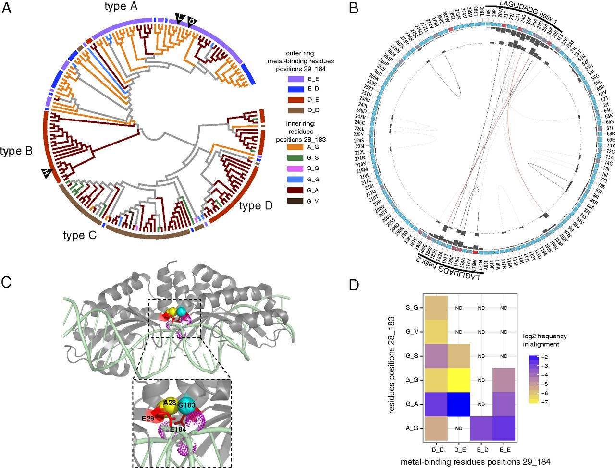
A coevolving network in LHEs involving catalytic and noncatalytic residues.
Thomas A. McMurrough et al. PNAS 2014;111:E2376-E2383
Notes:
A coevolving network in LHEs involving catalytic and noncatalytic residues. (A) A cladogram of single-chain LHEs generated from an unrooted maximum-likelihood tree made by PhyML. The outer ring is colored according to the identity of the metal-binding residues at positions 29 and 184, and the branches leading to the tips are colored according to the identity of residues at positions 28 and 183, as indicated. Each class is colored by the residue 28_183 combination at the deepest branch, with no assumptions made regarding an ancestral state. The locations of the I-LtrI, I-OnuI and I-HjeMI endonucleases are denoted by triangles containing the first letter of the endonuclease. (B) Circos plot (44) illustrating covariation scores between residues of LHEs, mapped onto I-LtrI sequence. The outer ring shows I-LtrI residue number and identity for positions within the LHE alignment. The next ring shows amino acid conservation using a heat map (with red indicating “most conserved” and blue indicating “least conserved”) and bar plot. The internal ring shows covariation scores using bar plots, with height of the bar proportional to the covariation score. Red lines connect positions with the highest covariation scores, black lines connect positions with intermediate scores, and gray lines connect positions with the lowest scores. (C) Covarying positions A28 (yellow), G183 (teal), and E29 and E184 (red) mapped onto the structure of I-LtrI (blue, Protein Data Bank 3R7P) in the presence of DNA substrate. Magnesium cofactors (violet) are shown as dotted spheres. (D) Heat map of residue combinations in the LHE sequence alignment for positions 28, 29, 183, and 184 plotted on a log₂ scale. Identities of the metal-binding residue at positions 29 and 184 are on the x axis, and identities of residues at positions 28 and 183 are on the y axis. Combinations of residues at positions 28 and 183 that were observed once in the LHE alignment (G_T, G_R, and G_D) are not plotted. ND, residue combination not detected in alignment.

Slide 31
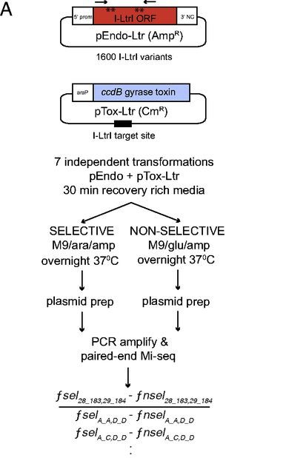
Competition growth experiments.
Worst possible dataset
Full of 0 values
Very asymmetrical
Control samples are evenly distributed
Experimental samples are exponentially distributed and sparse
Some variants well behaved, some variants not so much
HTS data exposes all weaknesses
Thomas A. McMurrough et al. PNAS 2014;111:E2376-E2383
Notes:
Competition growth experiments reveal network preferences. (A) Schematic of the liquid competition growth experiment and sequencing strategy used to screen an I-LtrI mutant library. (B) Heat map containing the log₂ effect size (25) for quartet pairs with a false discovery rate of less than 0.05. The metal-binding residue identities for 29 and 184 are found along the x axis, and the identities of residues 28 and 183 are found along the y axis. Relative abundance values for all 1,600 possible quartets are found in Fig. S3.

Slide 32

Our approach
Phase 1:
Experiment
Phase 2:
Analyze
Phase 3:
Publish
Notes:
Competition growth experiments reveal network preferences. (A) Schematic of the liquid competition growth experiment and sequencing strategy used to screen an I-LtrI mutant library. (B) Heat map containing the log₂ effect size (25) for quartet pairs with a false discovery rate of less than 0.05. The metal-binding residue identities for 29 and 184 are found along the x axis, and the identities of residues 28 and 183 are found along the y axis. Relative abundance values for all 1,600 possible quartets are found in Fig. S3.

Slide 33
The biplot
Multivariate analysis of variance between the all vs. all ratios
Plots samples and variants concurrently
We can see that all controls essentially the same
Most variants essentially at the center of the plot – means unchanged between the two groups
Wide differences in the experimental samples, driven by a few variants
Some variants on the axis of the experiment, others off the axis
Notes:
Many more fragments than we can count

Slide 34
The effect plot
Univariate analysis of variance
Plot of Within : Between group difference
Sectors are constant effect size
Variants with high activity in top left corner
Variants with moderate activity effect > 4
Variants with barely detectable activity effect > 2
Variants with no activity effect < 2
Gloor and friends, under review
Notes:
Many more fragments than we can count

Slide 35
Results track biplot
Comp. 1
53% var
Notes:
Many more fragments than we can count

Slide 36
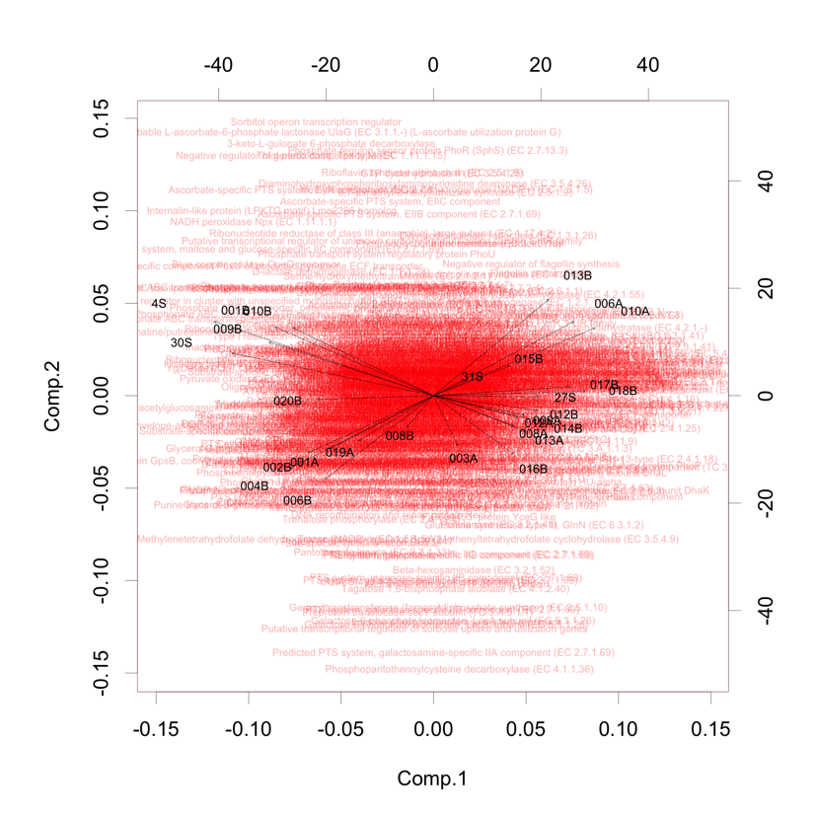
What about RNA-seq?
10% var
58% var

Slide 37
What about 16S rRNA profiles?
12% var
15% var

Slide 38
Correlations are the worst!
Any correlation that is reported must go through the origin to be real
The ratio of the parts is the only thing that can be observed
Notes:
Many more fragments than we can count

Slide 39
Correlate on what data?
Do we do correlations on counts?
Or normalized data (proportions)?
Lovell, PLoS Comp. Bio. 2015
Notes:
Many more fragments than we can count

Slide 40
Remove one
What if we remove some members from the group?
Lovell, PLoS Comp. Bio. 2015
Notes:
Many more fragments than we can count

Slide 41
The solution is …
Measuring constant ratios of components
Ø(x,y) = var(clr(x)/clr(y)) / var(clr(x))
Lovell, PLoS Comp. Bio. 2015
Notes:
Many more fragments than we can count

Slide 42
Correlations?
Kang, PLoS ONE 2013

Slide 43
But recall …

Slide 44
Conclusions
Sequencing is not counting
Machine capacity imposes constant sum constraint
High throughput sequencing datasets have significant variation
Variation is proportionally more extreme at low count margins
Modeling and accounting for this variation combined with placing data in the proper space reduces false positive identifications when conducting tests
The data we observe is one instance of the data we could have received
We need to get rid of the black box
Notes:
Many more fragments than we can count

Slide 45
“Bioinformatics”
The confluence of at least three fields of study
Biology asks the question
Computation makes it fast
Statistics gets the right answer
Cross-fertilization is poor

Slide 46
“Bioinformatics”
The confluence of at least three fields of study
Biology asks the question
Computation makes it fast
Statistics gets the right answer
Cross-fertilization is poor

Slide 47
“Bioinformatics”
The confluence of at least three fields of study
Biology asks the question
Computation makes it fast
Statistics gets it right
Cross-fertilization is poor

Slide 48
“Bioinformatics”
The confluence of at least three fields of study
Biology asks the question
Computation makes it fast
Statistics gets it right
Cross-fertilization is poor

Slide 49

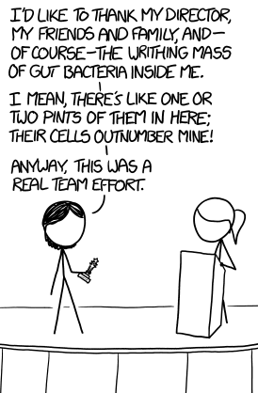
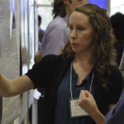
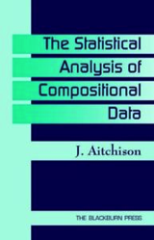
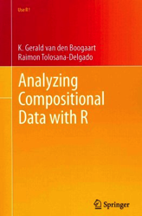

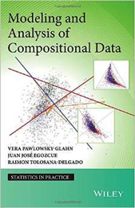
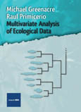


Acknowledgments / Sources
Gregor Reid!
Jeremy Burton
Notes:
Many more fragments than we can count

Slide 50
Technical replication
Normalized counts
CLR

